Slide 1
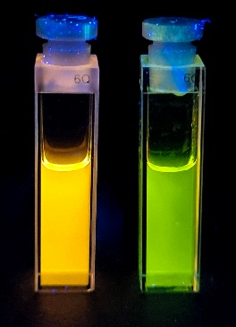
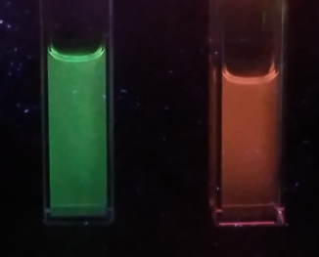
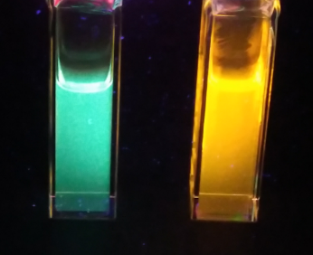
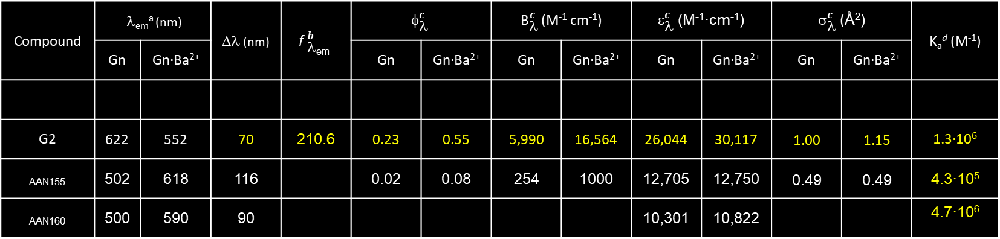
FBI·G1
FBI·G2
FBI·G3
AAN160
FBI·G4
FBI-G2
AAN-155
Compound | λ_{em}ª (nm) |  | Δλ (nm) | $${\text{f} }_{\text{l}\text{em}}^{b}$$ | $${\text{f}}_{\text{l}}^{c}$$ |  | ${\text{B}}_{\text{l}}^{c}$ (M⁻¹ cm⁻¹) |  | ${\text{e}}_{\text{l}}^{c}$ (M⁻¹·cm⁻¹) |  | ${\text{s}}_{\text{l}}^{c}$ (Å²) |  | K_{a}^{d} (M⁻¹)
 | Gn | Gn·Ba²⁺ |  |  | Gn | Gn·Ba²⁺ | Gn | Gn·Ba²⁺ | Gn | Gn·Ba²⁺ | Gn | Gn·Ba²⁺
G2 | 622 | 552 | 70 | 210.6 | 0.23 | 0.55 | 5,990 | 16,564 | 26,044 | 30,117 | 1.00 | 1.15 | 1.3·10⁶
_{AAN155} | 502 | 618 | 116 |  | 0.02 | 0.08 | 254 | 1000 | 12,705 | 12,750 | 0.49 | 0.49 | 4.3·10⁵
_{AAN160} | 500 | 590 | 90 |  |  |  |  |  | 10,301 | 10,822 |  |  | 4.7·10⁶
ª Emission wavelengths λ_{em} at a λ_{exc}_max .^{b} Peak discrimination factors (f_{λ}) with respect to unbound fluorophores Gn at λem. ^{c} All values for Quantum yields ф_{λ} , molecular brightness of the fluorescent emissions (B_{λ}), molar extinction coefficient at λ(G2) =325 nm; AAN155 and AAN160 at their isosbestic point λ(AAN155)= 365 nm; λ(AAN160)= 370 nm. ^{d} Ka with barium perchlorate in acetonitrile at 298 K using Nelder-Nelder mead fitting on the 300-500 nm spectral region.

Slide 2
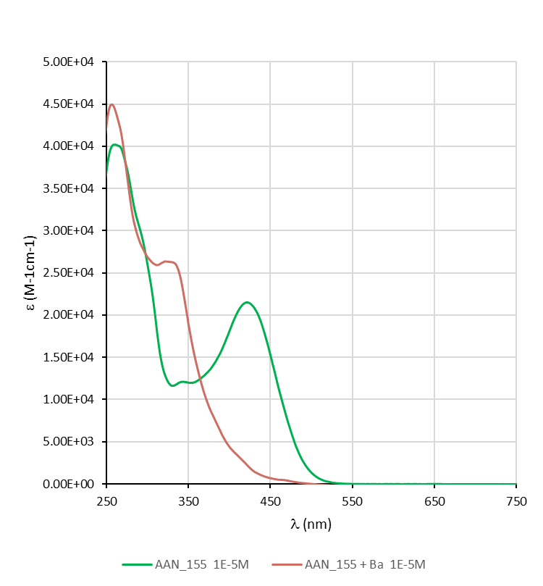
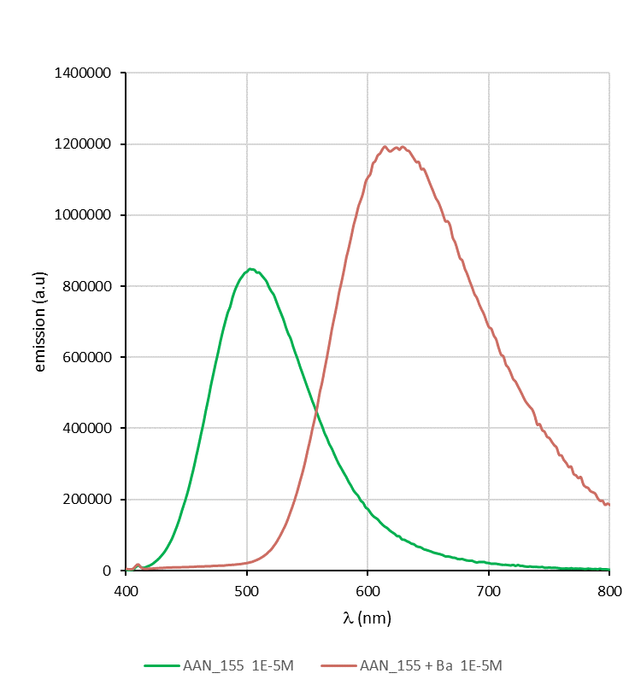
AAN155 absorption (1E-5M)
AAN155 emission (1E-5M)
Excitation at 365 nm

